Slide 1

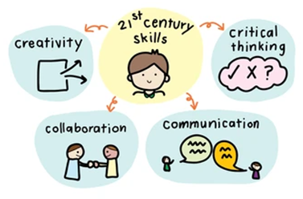
Welcome, my IU critical thinkers ☺
VIETNAM NATIONAL UNIVERSITY – HO CHI MINH CITY
INTERNATIONAL UNIVERSITY
Đỗ Thị Diệu Ngọc
School of Languages
dtdngoc@hcmiu.edu.vn
MS. Teams code: 8a31dhh

Slide 2

COURSE SUPPORT
Teaching assistant: Dương Thái Hùng
duongthaihung2003@gmail.com
Contact Thái Hùng for:
Assignment problems
Attendance check
Confusion about lesson contents
Link to join TA group:
Deadline: End of Week 1

Slide 3
COURSE DESCRIPTION
Why are you here?
Why
What to get from
the course?
Who you will be?
Who
What
5W1H
When to look for resources?
When
How
How to get your knowledge & skill?
Where
Where to get resources?

Slide 4

COURSE DESCRIPTION
Textbook: Critical Thinking: A Student's Introduction, 6th ed. (Bassham, Irwin, Nardone, and Wallace)
Course length: 45 periods/15 weeks
Course Assessment:
Quizzes + assignments : 30%
Mid-term exam : 30%
Final exam : 40%
(Final exam: written test x 3+ group project x2)/5
Link to register groups (7-8 students for assignments and final project):
https://docs.google.com/spreadsheets/d/10v-wXSHITQ4Gs_8zXgwiNE2AbBQpSBhp/edit#gid=930700224
Deadline: End of Week 2
Notes:
https://docs.google.com/spreadsheets/d/12bi4PB5BGtIqprPVV_lkbE95aJ5nSzkb/edit?usp=share_link&ouid=100336012683054052142&rtpof=true&sd=true

Slide 5


Slide 6
CHAPTER 1
INTRODUCTION TO CRITICAL THINKING
Definition of critical thinking
Standards of critical thinking
Benefits of critical thinking
Barriers to critical thinking
Characteristics of a critical thinker
6

Slide 7
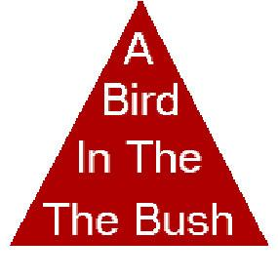
Let’s take the first step into Critical Thinking

Slide 8
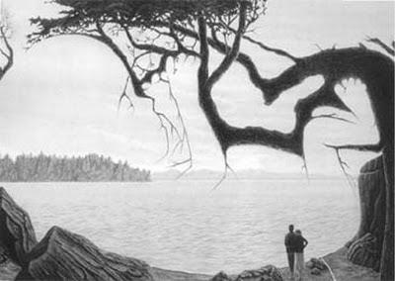
Let’s take the first step into Critical Thinking

Slide 9
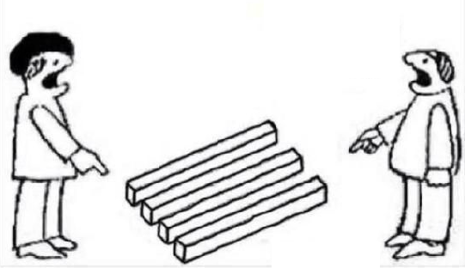
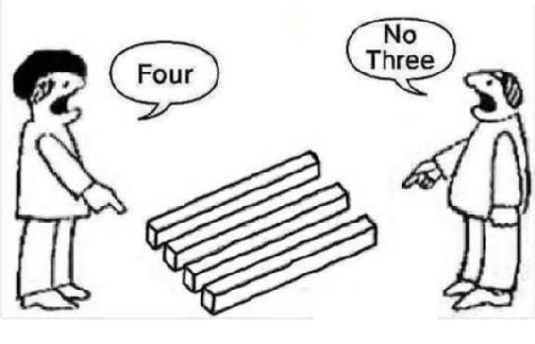
Let’s take the first step into Critical Thinking

Slide 10
CRITICAL THINKING
WHAT to think or HOW to think?

Slide 11

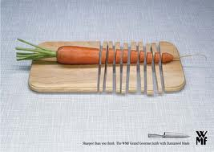
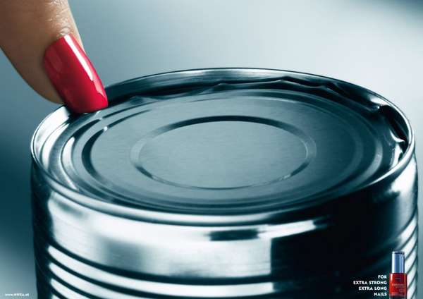

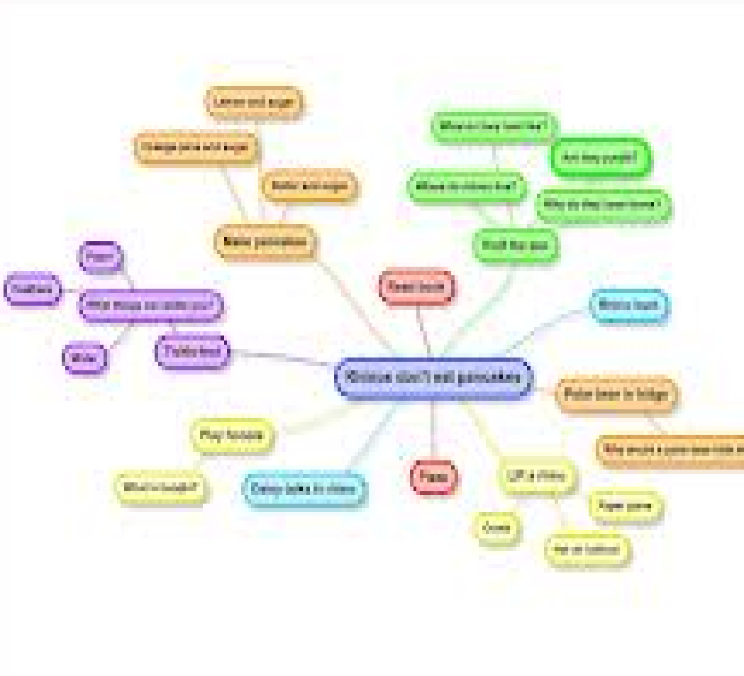
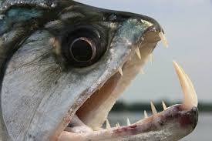
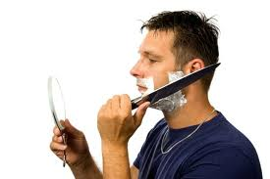
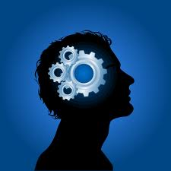
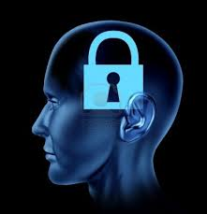
ARE YOU A CRITICAL THINKER?

Slide 12
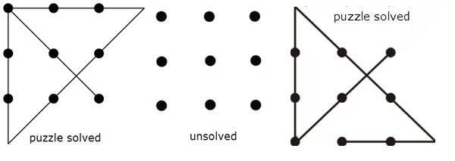
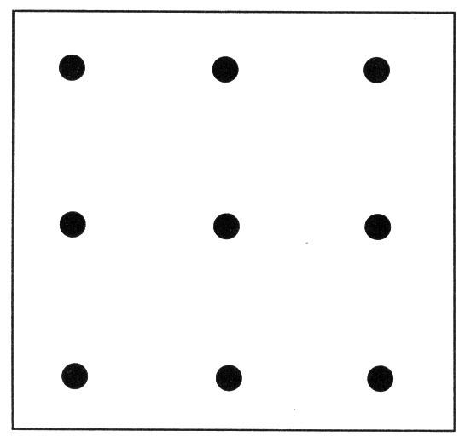
Connect the 9 dots with 4 lines without lifting your pen.
ARE YOU A CRITICAL THINKER?

Slide 13

ARE YOU A CRITICAL THINKER?
How many uses of the paper clip can you think of?

Slide 14
ARE YOU A CRITICAL THINKER?
Nail cleaner
Toothpick
Emergency belt holder
Inexpensive earrings/nose ring/ necklace, bracelet, ring
Skeleton key
Key chain
Bookmark
Mobile phone sim remover
Bottle/nipple unclogger
School holiday provider (combined with a rubber band)

Slide 15
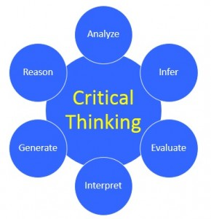
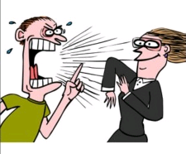
1. DEFINITION OF CRITICAL THINKING
- “Critical” here does not mean “negative”
- Critical thinking means skilled observation and/or judgment by clear intellectual standards

Slide 16
2. STANDARDS OF CRITICAL THINKING
accuracy
precision
relevance
clarity
Critical thinking
consistency
logic
fairness
completeness

Slide 17
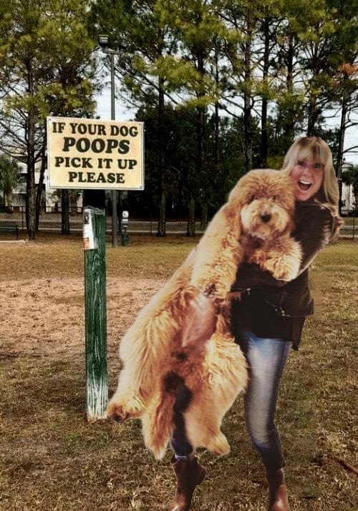

WHICH STANDARD IS MISSING?
Missing clarity

Slide 18

Accuracy vs. Precision

Slide 19
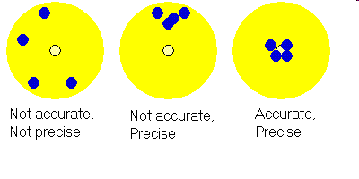
Precise or accurate?
- Accuracy: True, not False
- Precise: Specific, not General

Slide 20
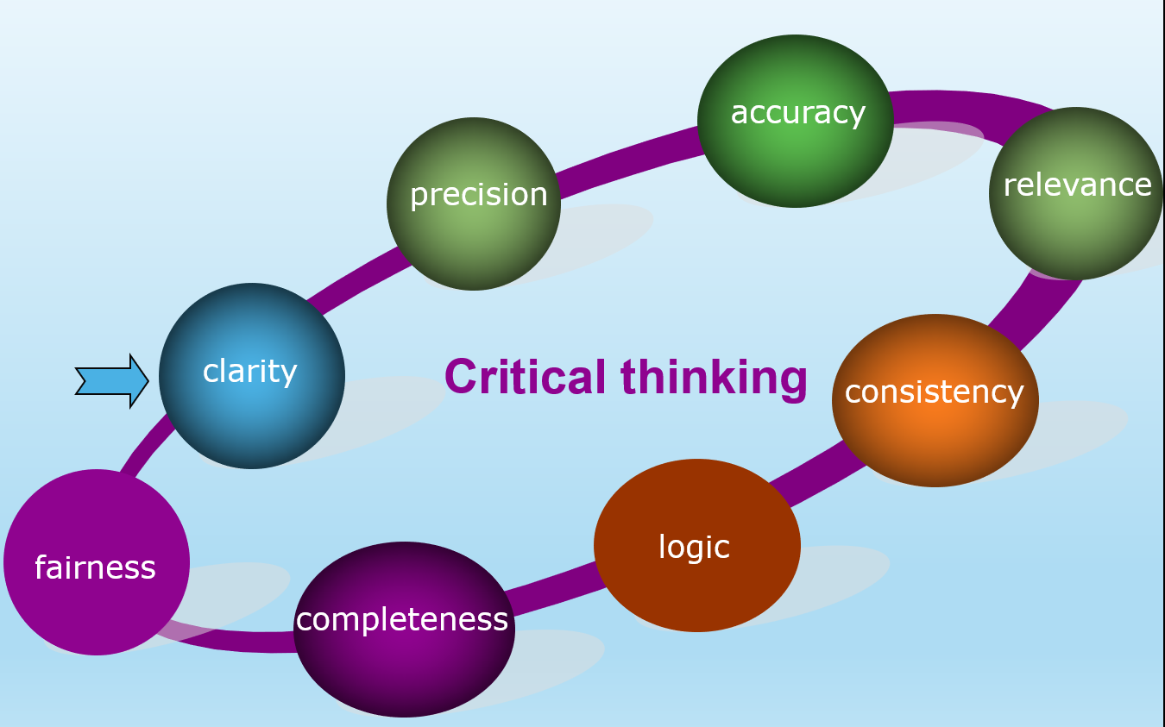
WHICH STANDARD IS MISSING?
Teacher: “Some students are absent from class today. They are not here because they had registered but then dropped.”
→ Question to check accuracy: Is that really true?
Missing accuracy

Slide 21
Which is more precise?
1. President Ho Chi Minh (in an interview in 1946): I only have one ultimate desire, that is how to attain complete independence for my country and freedom for my people, to ensure that everyone has food to eat, clothes to wear, and access to learning.
2. Vietnam’s mission: Wealthy people, powerful country, fair, democratic and civilized society

Slide 22
WHICH STANDARD IS MISSING?
- Critical Thinking is a useful subject.
- Really? Why is it useful?
- Yeah, it’s really helpful.
- ???
→ Question to check precision: Can it/you be more specific?
Missing precision

Slide 23
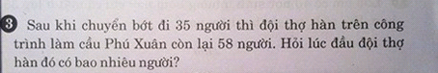
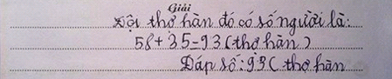
Can you solve this problem?
After transferring 35 people, there are 58 people in the group of welders on the bridge. How many welders were there initially?
No, the math problem is not PRECISE: who are those 35 people? Can they be builders or vendors?

Slide 24
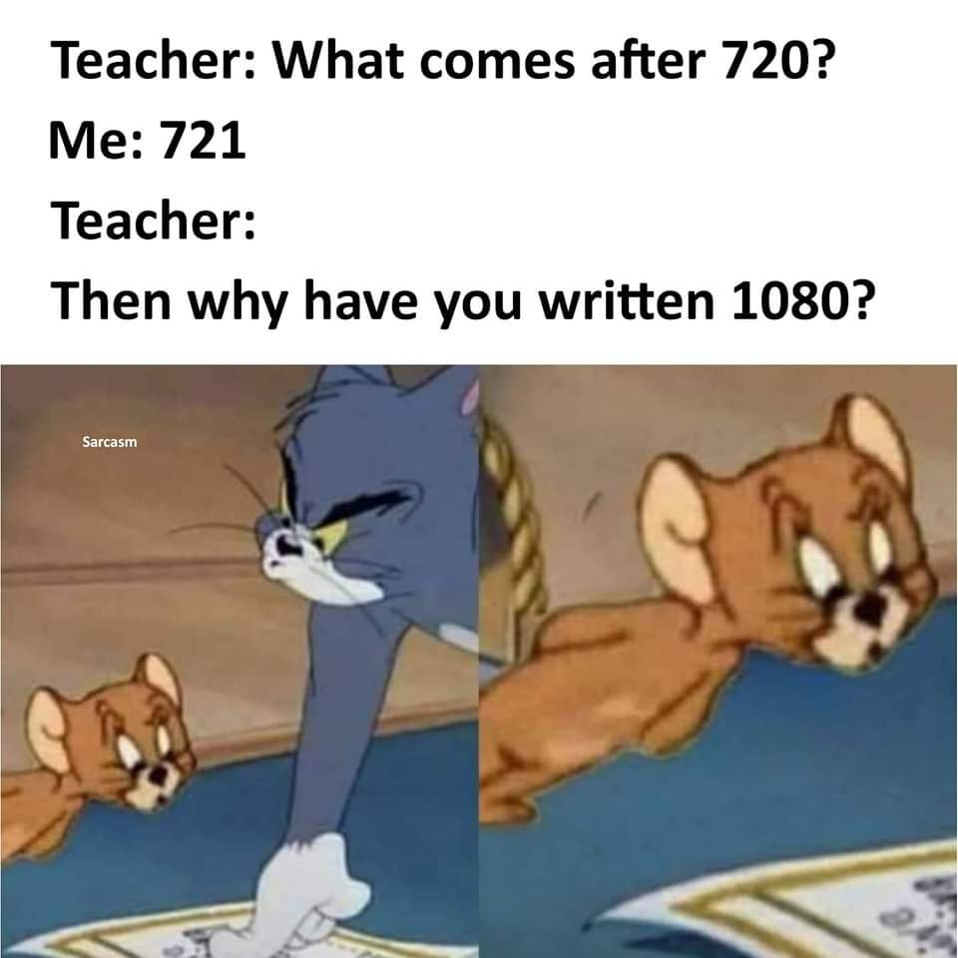

Can you answer the teacher’s question?
Because I’m a movieworm?
Notes:
The teacher’s question lacks precision.

Slide 25

WHICH STANDARD IS MISSING?
Hoàng hôn là dải lụa Còn màn đêm là tấm chăn Mỗi đêm ta ngồi ta viết, ta chỉ mong không bị cấm ngăn Nhởn nhơ trên con đường vắng, tự nhủ mình không cần tăng ga Lắng nghe cuộc đời như lá, lá rơi nghiêng như Trần Đăng Khoa Lời ca là chất kích thích, cho cuộc đời thêm phần thăng hoa
Đen - Lộn xộn 3
Relevance

Slide 26
Which fact is not relevant?
VNU-HCM is one of the largest educational institutions of Vietnam. The university has major member universities in South Vietnam, including the University of Technology, University of Science, University of Social Sciences and Humanities, International University, University of Information Technology, University of Economics and Law, University of Forestry and Agriculture, and An Giang University.
University of Forestry and Agriculture does not belong to VNU-HCM.

Slide 27
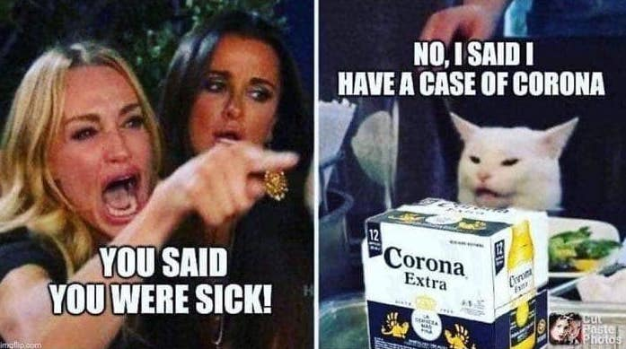
WHICH STANDARD IS MISSING?
Missing relevance

Slide 28
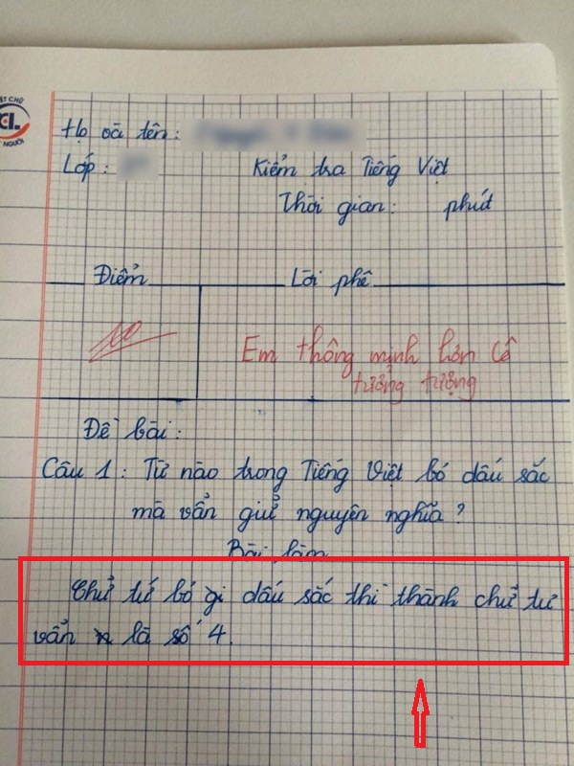
Do you agree with the teacher’s evaluation?
Notes:
https://soha.vn/tu-nao-trong-tieng-viet-bo-dau-sac-ma-van-giu-nguyen-nghia-bo-me-bat-ngo-truoc-cau-tra-loi-cua-con-20170728101159175.htm

Slide 29
WHICH STANDARD IS MISSING?
A: Which do you favor: happy moments with your family or happiness counting money?
B: I love being with my family, of course.
A: What can you do for your family?
B: I work day & night to earn money for them.
Missing logical consistency

Slide 30
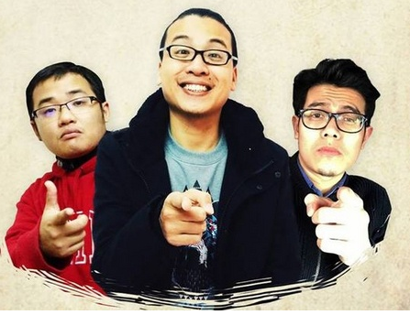
WHICH STANDARD IS IT?
MỘT NHÀ
Khi hai ta về một nhà Khép đôi mi chung một giường Đôi khi mơ cùng một giấc Thức giấc chung một giờ Khi hai ta chung một đường Ta vui chung một nỗi vui Nước mắt rơi một dòng Sống chung nhau một đời
Logical consistency

Slide 31
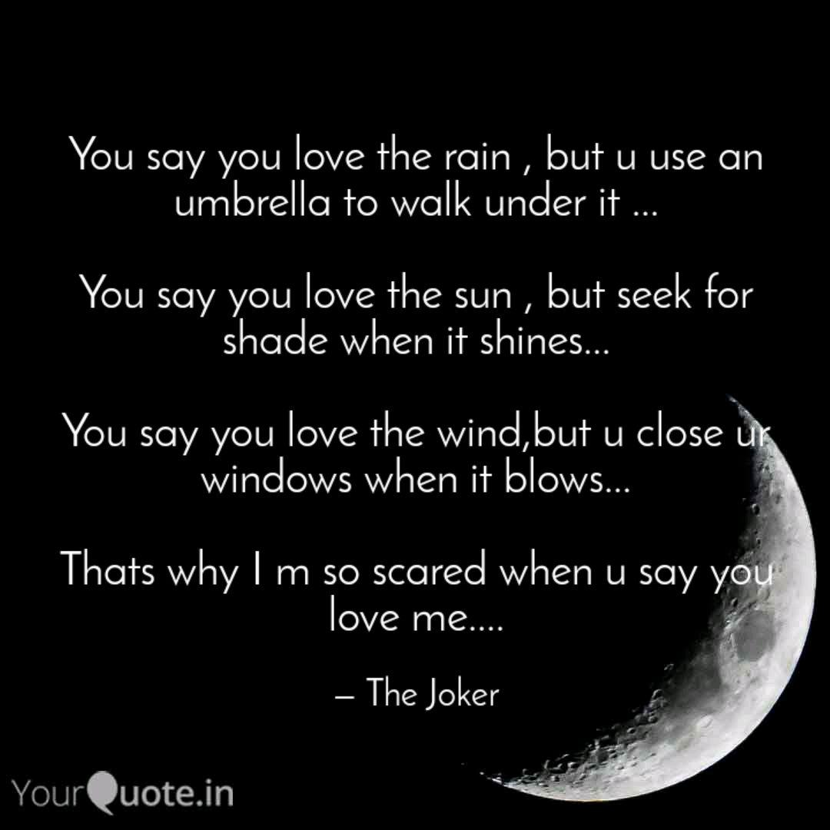
WHICH STANDARD IS MISSING?
Missing practical consistency

Slide 32
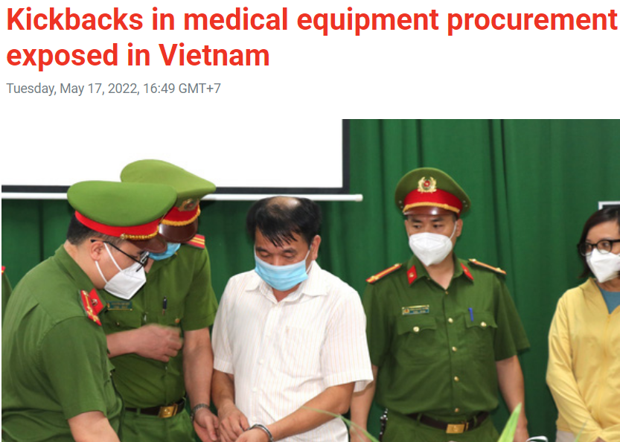
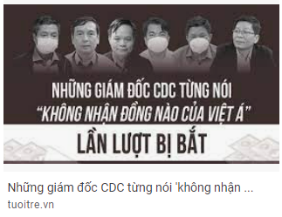
WHICH STANDARD IS MISSING?
So far, more than 30 health officials, including three seniors from the Ministry of Health and the Ministry of Science and Technology, and eight directors of provincial centers for disease control (CDC), have been arrested for receiving 'commissions' as kickbacks from Viet A Technology Corporation (Viet A Corp.), which had illegally raised prices of test kits to earn huge profits. They all claimed not to have received any commissions from Viet A Corp.
Missing practical consistency

Slide 33

Does the nun make a right decision?
Nun: I have to wear a bathrobe when having a bath. Because God sees everything, he will see through the door.
No, if God sees everything, He can see through her bathrobe.
Missing logical correctness

Slide 34
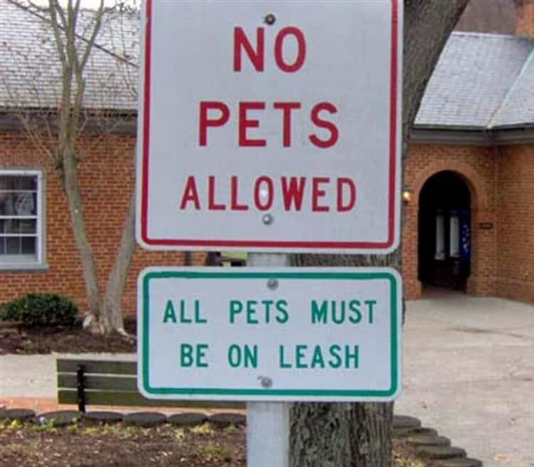
Which standard is missing?
Missing logical correctness

Slide 35
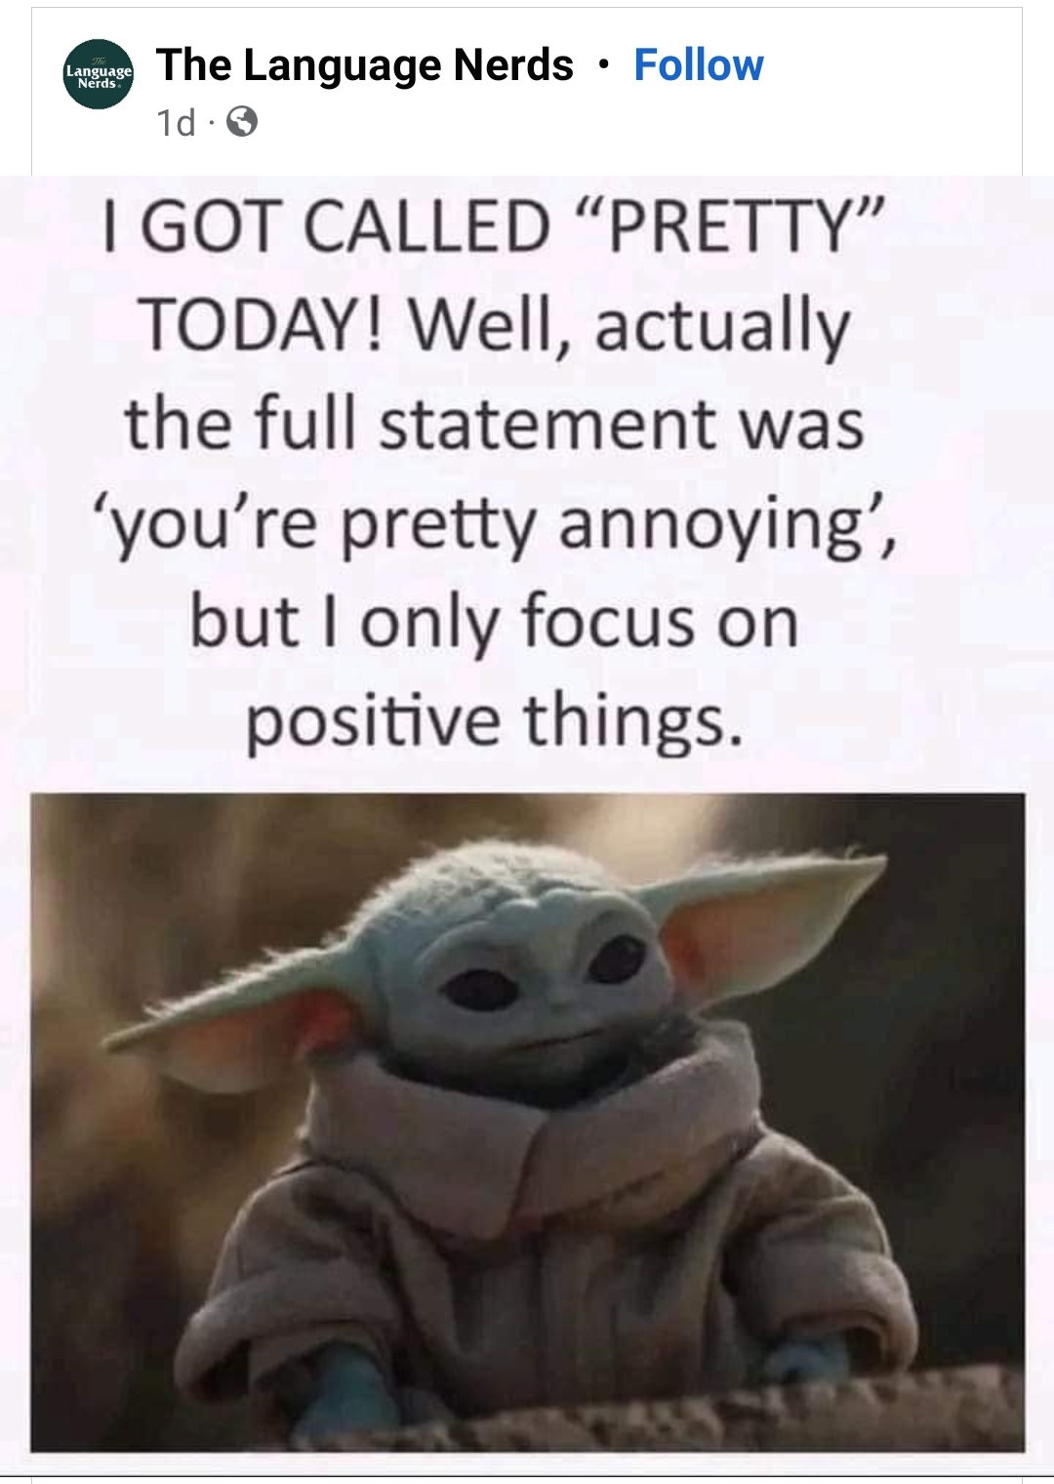
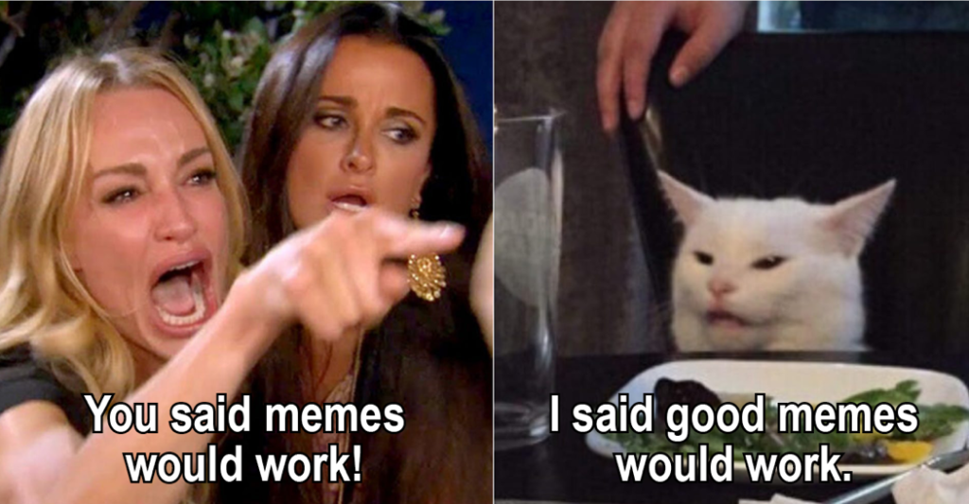
WHICH STANDARD IS MISSING?
Missing completeness

Slide 36

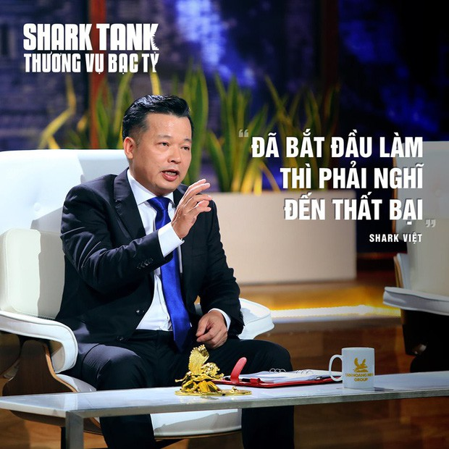
DO THE TWO SHARKS CONFLICT?
When you start up a business, don’t think about failure.
When you start up a business, do think about failure.
Optimism
Constructive pessimism
Nope, they complete the point being discussed.

Slide 37
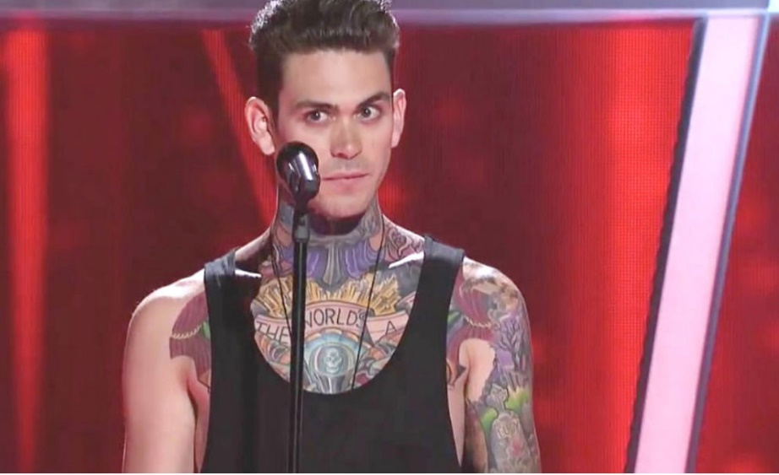

WHICH STANDARD IS MISSING?
A: A singer and a principal with tattoos? Unacceptable!
Missing fairness

Slide 38
It’s your turn: Which standard is missing?

Slide 39
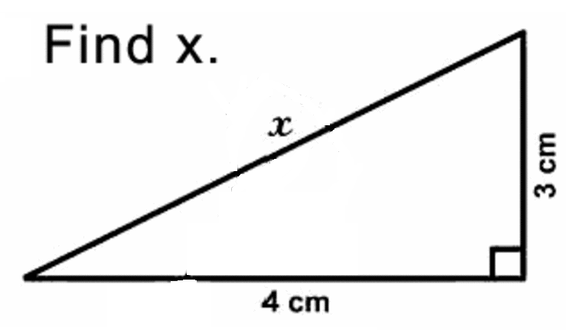
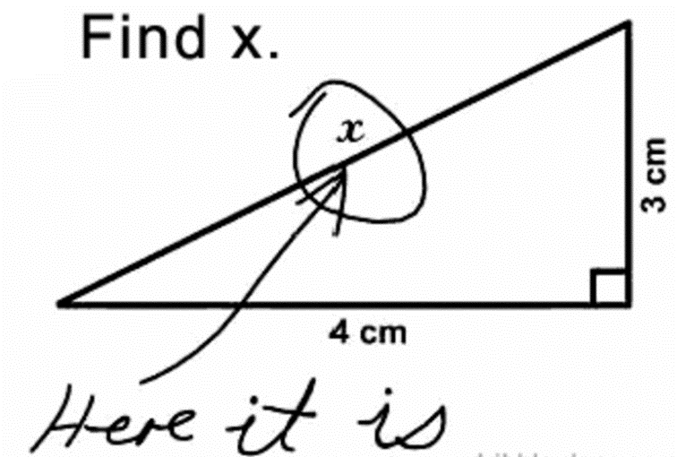
Which standard is missing?
1.
2. Q. What skills do you think you possess to lead the company in the right way?
A. Well I do have some good management skills. I can efficiently control my children and carefully plan our family budget.

Slide 40
Which standard is missing?
He’s a countryside man. Inviting him to a party at a five-star hotel is like pulling a fish out of water.
What I hate the most is seeing people waste money on luxury things while others are starving. Last week I saw Kim in a Louis Vuitton shop. I was busy with my bags, so I couldn’t come to tell her to stop burning her money.
Take any vaccine you are offered; it will definitely save your life.

Slide 41
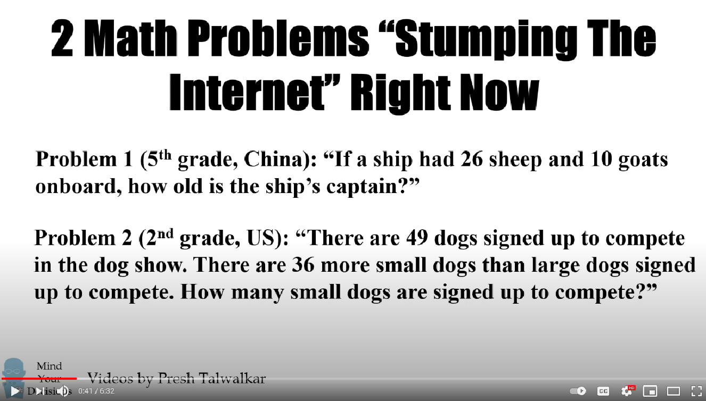
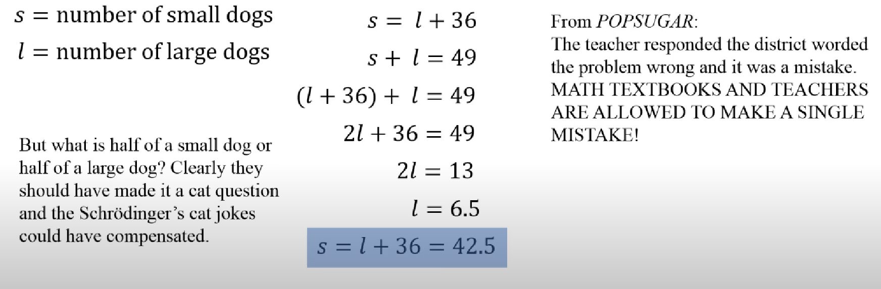
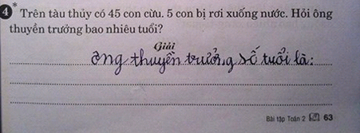
Which standard is missing?
Notes:
https://www.youtube.com/watch?v=A8aMJw6fY3w
https://mindyourdecisions.com/blog/2018/02/08/the-real-answer-to-the-viral-chinese-math-problem-how-old-is-the-captain-stumping-the-internet/

Slide 42
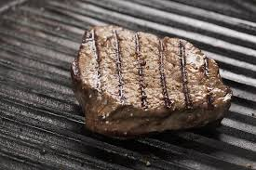
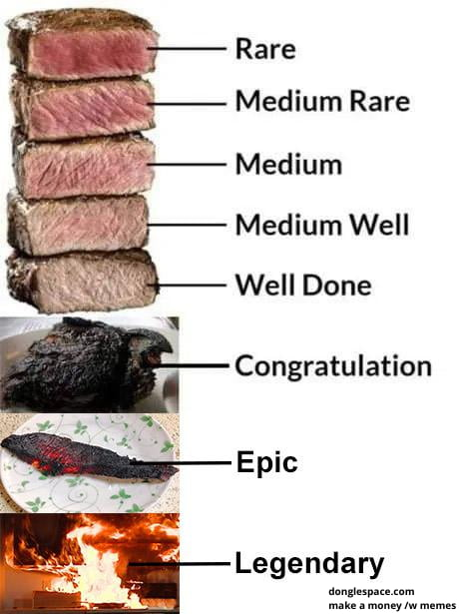
Which standard is missing/present?
precision
inconsistency
Missing precision
Source: https://9gag.com/gag/apgj9GE
https://www.epicurious.com/recipes/food/views/pan-grilled-steak-230680
Notes:
Lâm Nhật Nam – BTCEIU21098
Trương Nguyễn Vũ Hoài_BTBTUN21023
Nguyễn Thị Kim Anh - IELSIU21257
Nguyễn Ngọc Phương Quỳnh - IELSIU21229
Phan Thành Đạt - IELSIU21271
Lữ Anh Kiệt-BTBTUN21024
Phạm Nguyễn Yến Nhi – IELSIU21341

Slide 43
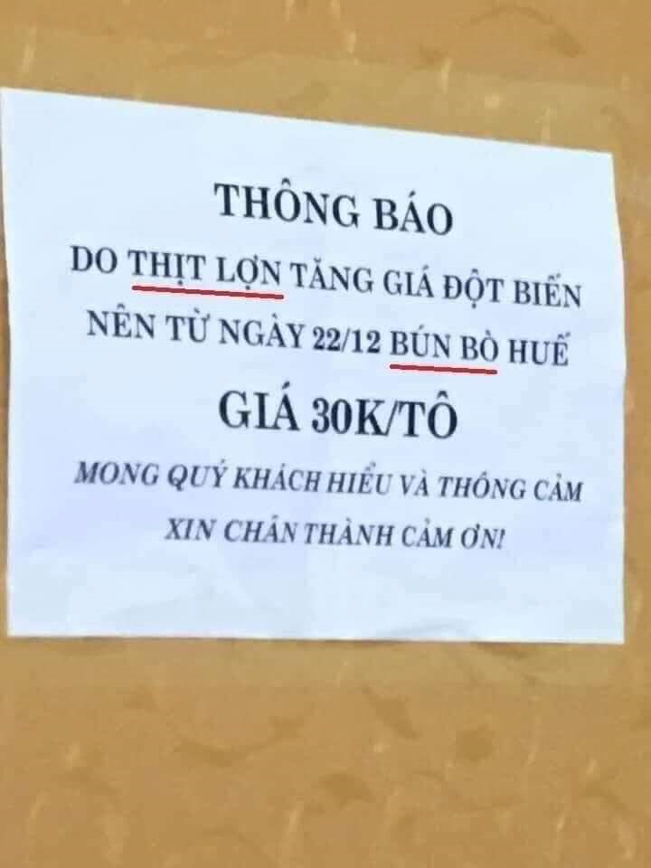
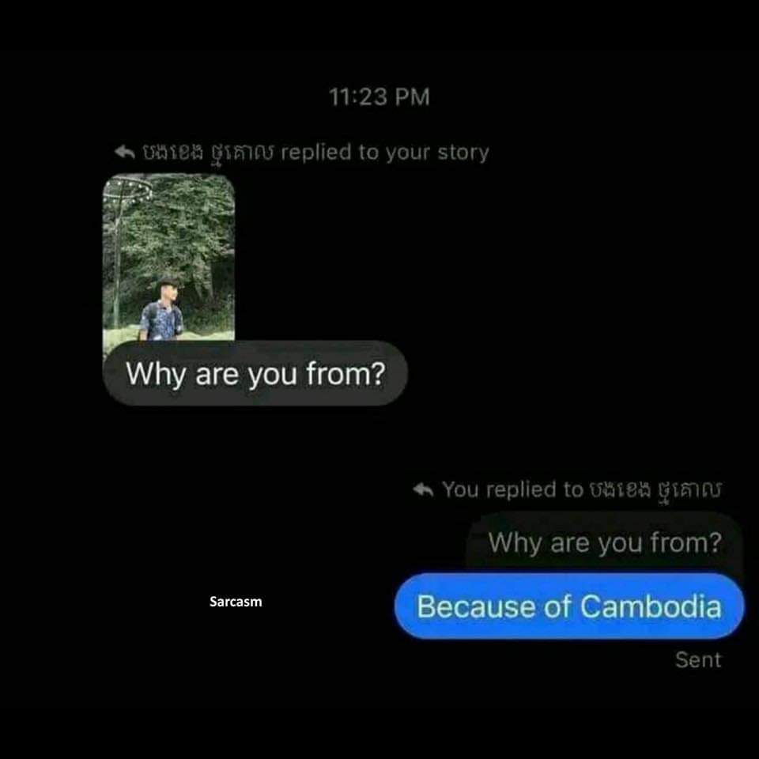
Which standard is missing/present?

Slide 44
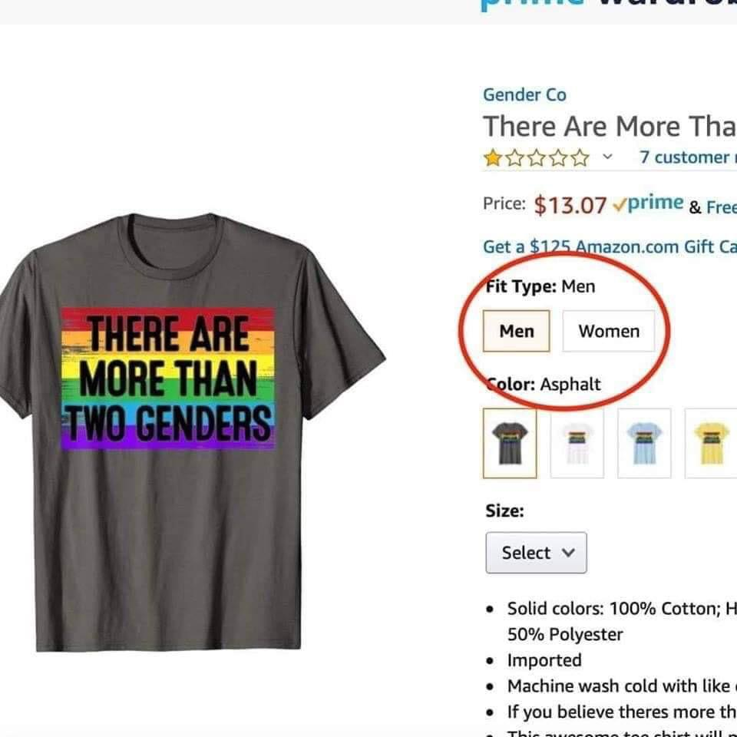
Which standard is missing?

Slide 45
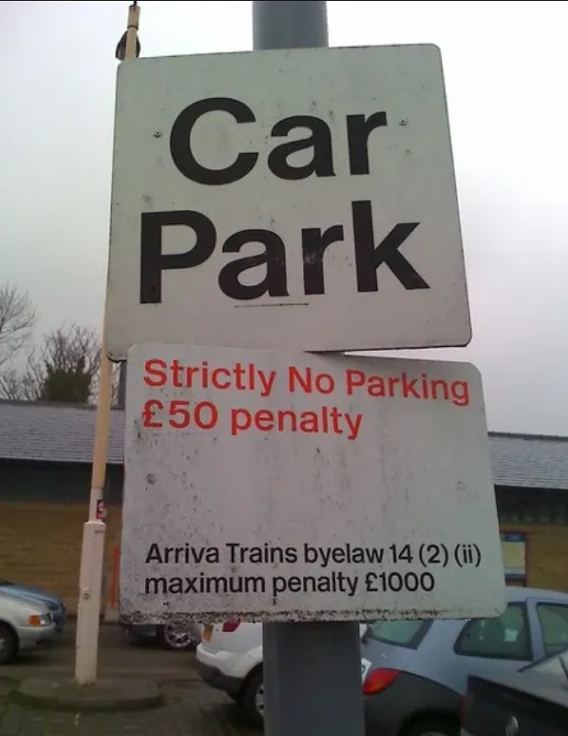

Which standard is missing?
Notes:
logical consistency/logic, clarity

Slide 46
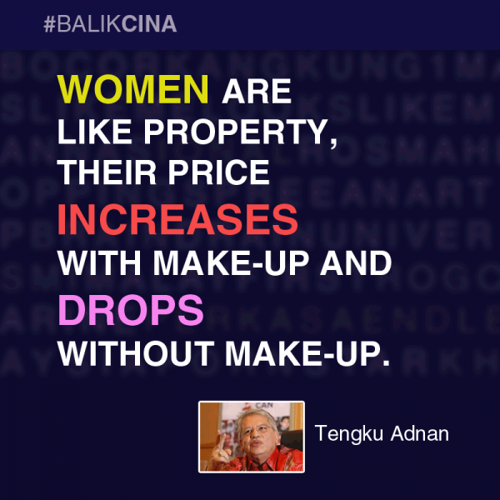
Which standard is missing?
Notes:
Fairness

Slide 47
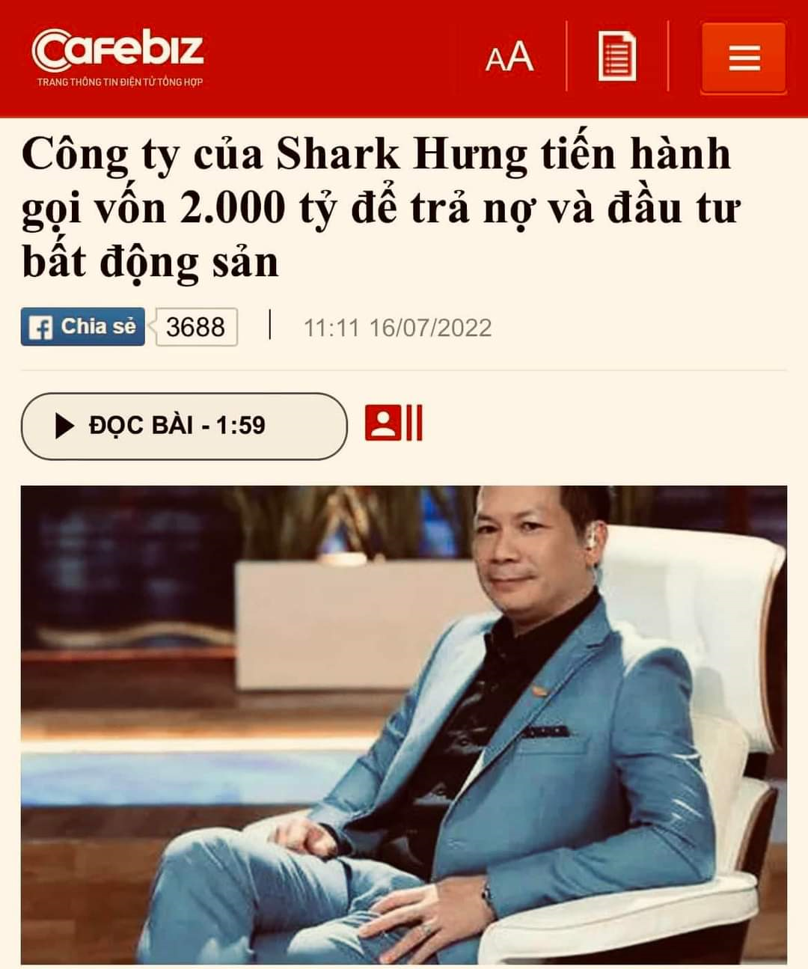
Which standard is missing?

Slide 48
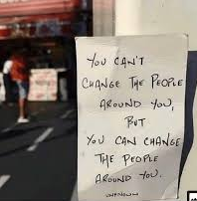
Which standard is missing?
‘You can’t change people around you, but you can change people around you.’
(Unknown)

Slide 49
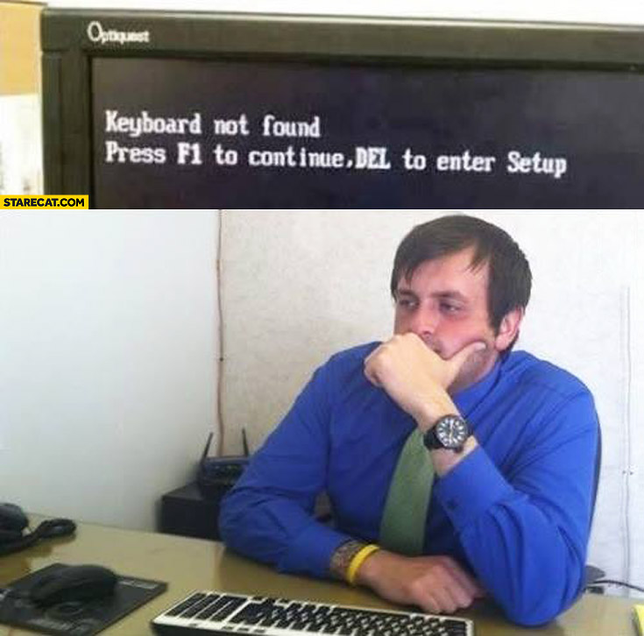
Which standard is missing?

Slide 50
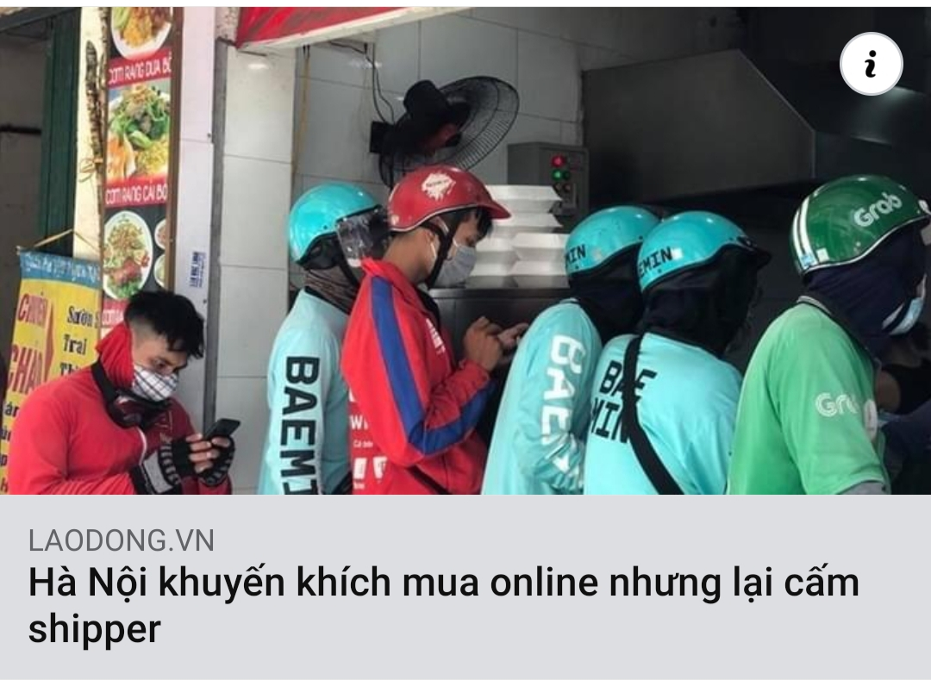
Which standard is missing?

Slide 51
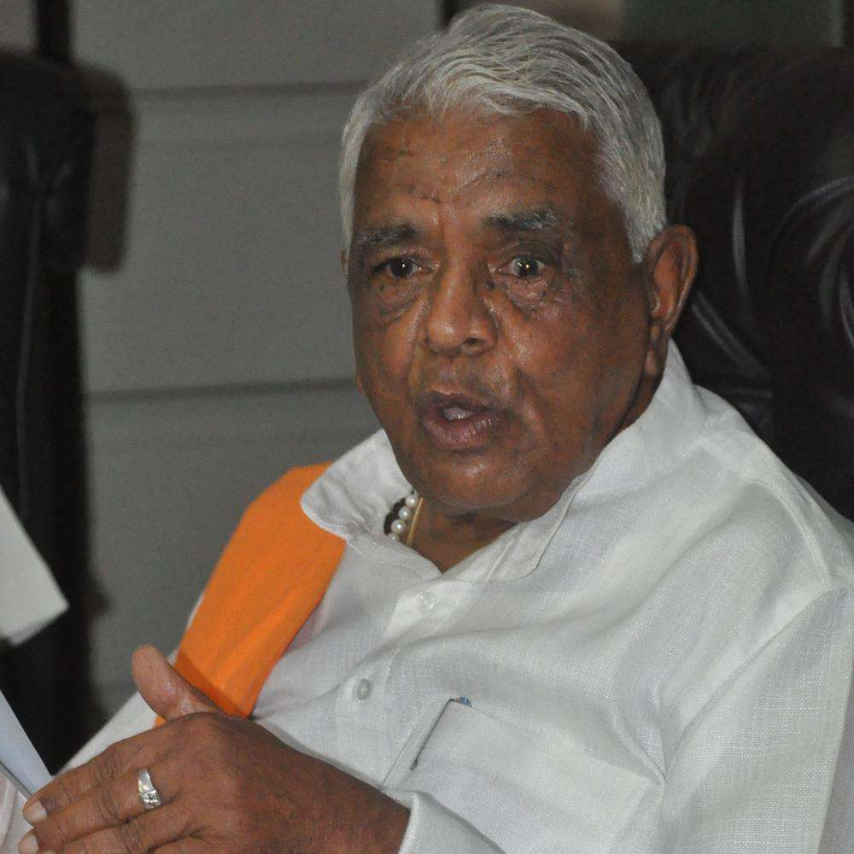
Which standard is missing?
"This (rape) is a social crime which depends on the man and the woman. It is sometimes right and sometimes wrong."
Babulal Gaur Yadav (Indian politician, 2014)
Notes:
Logic

Slide 52

Which standard is missing?
Oh, I ran out of gas but I can’t stop for a refill now. I’m busy with my driving!
Notes:
Logic/Logical correctness

Slide 53
3. BENEFITS OF CRITICAL THINKING
In the classroom
In the workplace
In life

Slide 54
In the classroom
Understanding and critically evaluating the arguments and beliefs of others
Developing and defending one’s own well-supported arguments and beliefs

Slide 55
In the workplace
Showing highly specialized skills to employers:
Communicate clearly and effectively
Gather and analyze information
Draw appropriate conclusions from data
Solve problems
Think creatively

Slide 56
In life
Preventing people from making foolish personal decisions
Promoting good decisions for the benefit of the people

Slide 57
4. MAJOR BARRIERS TO CRITICAL THINKING
Egocentrism
Sociocentrism
Unwarranted assumption
Relativistic thinking
Wishful thinking

Slide 58


EGOCENTRISM
Tendency to see reality as centered on oneself.
1. Self-interested thinking: tendency to accept and defend beliefs that harmonize with one’s beliefs.
2. Self-serving bias/Superiority bias: tendency to overrate oneself
Self-interested thinking
Self-serving bias/superiority bias
Notes:
https://symbolsage.com/narcissus-greek-mythology/

Slide 59



SOCIOCENTRISM
Group-centered thinking
1. Group bias: tendency to see one’s group (nation, tribe, peer group…) better than others.
2. Tribalism: Strong feelings of loyalty to, and identification with, one’s tribe or social group
3. Conformism: Allowing beliefs to be shaped by outside forces such as groups or authorities
Group bias
Political tribalism
Conformism
Notes:
Group bias: The ugly duckling (the young wild swan) physically and verbally abused by other duckling of the same flock
Democratic vs. Republican Parties in the U.S.
Employees fearful of saying “No” to their boss

Slide 60




UNWARRANTED ASSUMPTION
Claiming that something is true without true evidence.
Notes:
https://www.dailymail.co.uk/news/article-7920573/Revolting-footage-shows-Chinese-woman-eating-bat-scientists-link-coronavirus-animal.html

Slide 61


STEREOTYPE
Assuming that all people within a group (for example, sex or race) share all the same qualities.
61
Notes:
https://www.nytimes.com/2021/02/21/opinion/anti-asian-violence.html

Slide 62

Task: Analyze the stereotype and unwarranted assumption

Slide 63


RELATIVISM
The view that truth is a matter of opinion.
1. Subjectivism: truth is a matter of individual opinion.
2. Cultural relativism: truth is a matter of social or cultural opinion.
Which barrier is each opinion?
Subjectivism
Cultural relativism
Notes:
https://www.buzzfeed.com/michellerennex/all-food-is-good-homies

Slide 64


WISHFUL THINKING
Believing something not because you have good evidence for it but because you wish it were true.
I wanna become a policeman.
I wanna become a scientist.
Wishful thinking
Feasible wishes

Slide 65
See the differences
Janie : Professor, I don’t understand why you gave me a D on this paper. I checked my answers carefully and I thought I deserved an A.
Prof. : Well, you don’t offer any reasons to back up your opinions.
Janie : Why do I have to give reasons for my opinions when I’m entitled to hold them and no one can prove that they’re wrong? Besides, I’m much better than Mary, but she got a B while I got a D. It’s not fair, Professor!
self-serving bias
subjectivism
unwarranted assumption
65

Slide 66
5. Characteristics of a critical thinker
Are you open minded about other people’s view?
Are you honest to yourself (or others) when you are wrong?
Do you have the courage and passion to take initiative and confront problems and meet challenges?
Are you aware of your own biases and preconceptions?
Do you welcome criticism from other people?
Do you have independent opinions and are not afraid to disagree?

Slide 67
PRACTICE
Which barrier to critical thinking
can you recognize?

Slide 68

Question 1
Notes:
https://www.deccanchronicle.com/opinion/columnists/150320/caste-kills-more-in-india-than-coronavirus.html
Socio-centrism: group bias/tribalism

Slide 69




Question 2
Notes:
Cultural relativism
http://www.26k-estimation.com/html/worth_reading.html
https://www.snopes.com/fact-check/bread-and-media-circuses/

Slide 70

Question 3
Malaysia declares that men wearing V-necks are gays.
https://www.theatlantic.com/international/archive/2012/09/malaysia-declares-v-necks-gay/323576/
70
Notes:
Stereotype

Slide 71




Question 4
Notes:
https://www.euronews.com/2021/07/22/protest-in-france-after-women-fined-for-wearing-burkini-swimsuits-at-swimming-pool
https://www.theguardian.com/world/2016/aug/24/french-police-make-woman-remove-burkini-on-nice-beach
http://www.thanhniennews.com/world/three-more-towns-in-france-to-join-burkini-ban-65310.html
Cultural relativism

Slide 72

Question 5
Notes:
Ego-centrism - Self-serving bias

Slide 73

Question 6
Notes:
https://www.businessinsider.com/chinese-state-media-laughs-after-trump-falsely-claimed-victory-2020-11
Wishful thinking

Slide 74


Question 7

Slide 75

Question 8

Slide 76


Wrap-up: Critical Thinking in the East

Slide 77

Wrap-up: Critical Thinking for us
(idiom of Latin origin)
(Japanese proverb)
True critical thinkers: judge less - accept more

Slide 78
Review of Chapter 1
Critical thinking means skilled judgment or observation by clear intellectual standards
Eight standards of critical thinking:
Clarity
Accuracy
Precision
Relevance
Consistency
Logical correctness
Completeness
Fairness
Barriers to critical thinking:
Egocentrism
Sociocentrism
Unwarranted assumption
Relativistic thinking
Wishful thinking

Slide 79
ASSIGNMENT
Find five real-life examples (with sources): one student contributes ONE example about each of the following:
lack or presence of standards of critical thinking
Barriers to critical thinking
Notes:
- Delete all the lesson slides, only keep the Assignment slides and resubmit your group file to the link below.
- All websites of critical thinking are excluded.
- Deadline: end of Sunday
Link to submit:
https://forms.gle/FAZwGh6ZxjJjCuvaA

Slide 80
Real-life Example
Chẳng hạn như phát ngôn của ĐB Đỗ Văn Đương: “Thực chất, luật sư ở Việt Nam chỉ bào chữa cho những người có tiền” (1). Khi bị nhiều luật sư yêu cầu ĐB xin lỗi vì đã “thóa mạ” nghề luật sư nhưng trả lời báo chí về phát ngôn của mình, ĐB này vẫn quả quyết: “Kiến nghị là chuyện của người ta. Không có chuyện phải giải trình gì cả”(2).
(1): Unwarranted assumption
Brief explanation: He takes it for granted; he believes it to be true without any proof or conclusive evidence.
(2): Self-interested thinking/Subjectivism
Brief explanation: He insists on his own opinion and ignores/denies the request to make him more sensible.
Source: Plo.vn. (2015, May 30). Phát ngôn của đại biểu Quốc hội thế nào cho đúng! PLO. https://plo.vn/phap-luat/phat-ngon-cua-dai-bieu-quoc-hoi-the-nao-cho-dung-558034.html.

Slide 81
Group number
Your full name + ID
Your full name + ID
Your full name + ID
Your full name + ID
Your full name + ID

Slide 82
Real-life Example 1
Input the text/picture here.
Brief explanation:
Source:

Slide 83
Real-life Example 2
Input the text/picture here.
Brief explanation:
Source:

Slide 84
Real-life Example 3
Input the text/picture here.
Brief explanation:
Source:

Slide 85
Real-life Example 4
Input the text/picture here.
Brief explanation:
Source:

Slide 86
Real-life Example 5
Input the text/picture here.
Brief explanation:
Source:

Slide 87

Attendance check (3 minutes)
https://forms.gle/ZAZy14Vvt8jzWXxD8

Slide 88


